Slide 1
Object Oriented Design (juke box)

Slide 2
Problem
Design a musical juke box using object oriented principles.

Slide 3
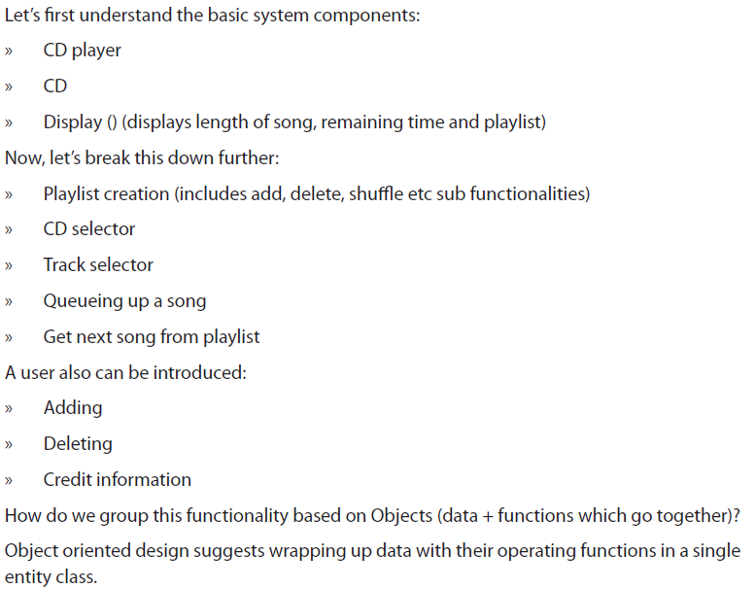
Solution

Slide 4
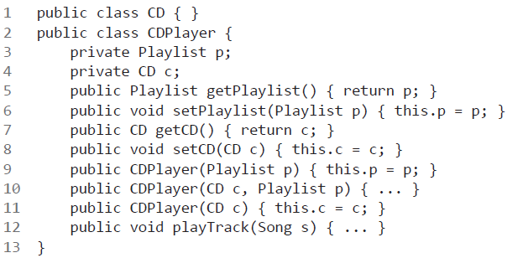

Slide 5
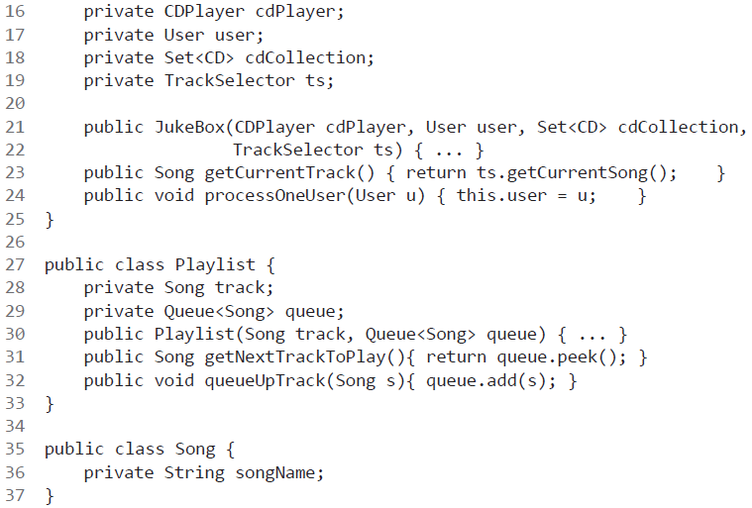

Slide 6
